Slide 1
Simple Forum
Software Studio 軟體設計與實驗
Hung-Kuo Chu
Department of Computer Science
National Tsing Hua University
CS2410

Slide 2
Simple Forum

Slide 3
Goal
Fork the repo Lab06-Simple Forum to your local repository.
Create a real-time forum by completing all TODOs
Create a new Firebase project name it Lab06 -[student-id] and change parameters in config.js
Complete button events in signin.js so that it has two ways to login/sign-up including email and google

Slide 4
Goal (Cont'd)
Complete logout button function and show alert when logout success or error
Let post button can push a new post to database
Show all post in database on webpage
After finishing all TODOs, deploy your forum to Firebase.
Recommend you to run a local server for testing and use Firefox as testing browser.

Slide 5
Grading Policy
TODO | Content | Score
1 | Setup Firebase project and connect to your local project | 15 %
2~5 | Firebase Auth | 40%
6 | Firebase Database write | 10 %
7 | Firebase Database read | 10 %
8 | Firebase Database rule (Hint : https://reurl.cc/O1VzYv) | 10 %
 | Firebase Hosting deploy | 15 %

Slide 6
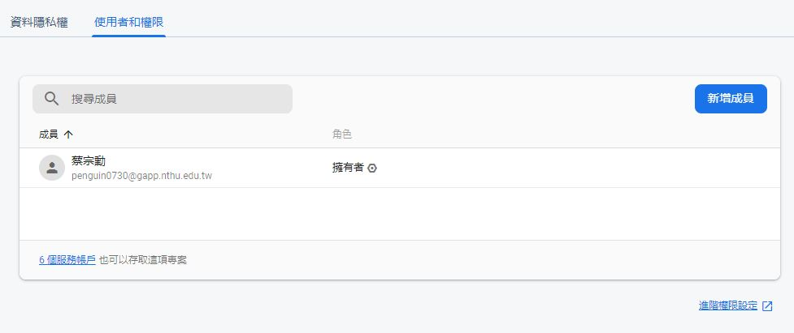
Add permission to TA’s account
Go project setting and select “Users and permissions”

Slide 7
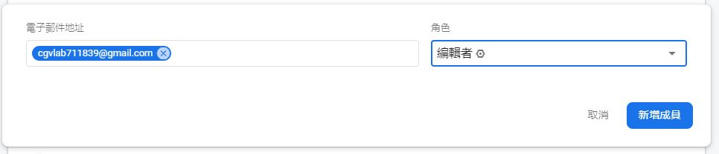
Add permission to TA’s account
Add cgvlab711839@gmail.com as editor to your project.

Slide 8
Goal (Cont'd)
Deadline: 2020/04/21 18:00 (commit time)
Deploy Firebase Hosting failed will get 0 point
Deploy delay is seen as commit delay
Commit your Firebase public link to google sheet.
Please add TA’s account to your Firebase project or you will get 0 point.
Please upload your source files to FTP and name your zip file as the following name format. Otherwise you will get 0 point.
Lab06_[studentID]_v1.zip
Lab06_[studentID]_v2.zip
…

